Slide 1
Airbnb NYC Analysis Report
Data Exploration, Cleaning, and Price Prediction
- Mathe SriLatha

Slide 2
Dataset Overview
• Dataset contains 48,895 listings from Airbnb in NYC
• Features include host details, neighbourhood, location, room type, price, reviews, availability
• Objective: Explore the data, clean it, and build predictive models for price

Slide 3
Data Cleaning
• Missing values handled:
– 'name' and 'host_name' filled with 'Unknown'
– 'reviews_per_month' filled with 0
– 'last_review' dropped as not useful for prediction
• Outliers:
– Prices > $1000 removed
– Minimum nights capped at 365
• Final dataset shape: 48,631 rows × 16 columns

Slide 4
Exploratory Data Analysis
• Listings by Neighbourhood Group
• Room Type Distribution
• Price Distribution
• Availability Patterns

Slide 5
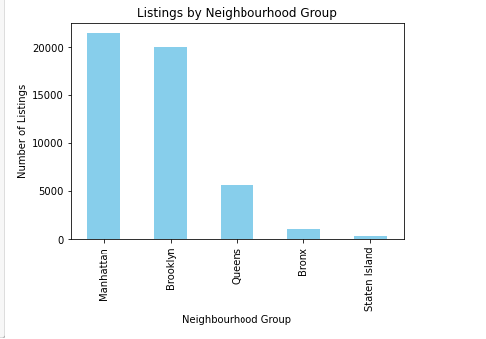
Listings by Neighbourhood Group

Slide 6
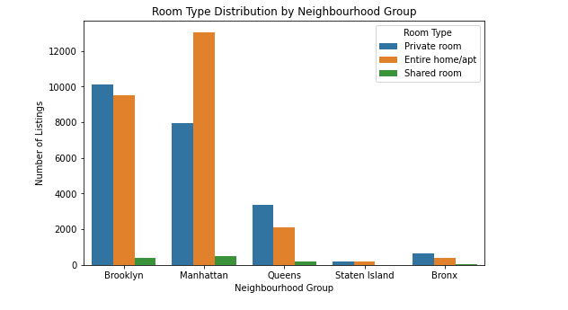
Room Type Distribution

Slide 7
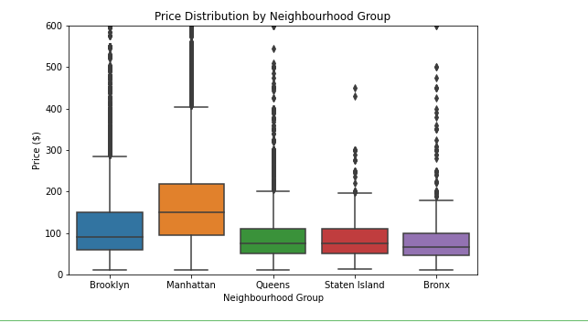
Price Distribution by Neighbourhood

Slide 8
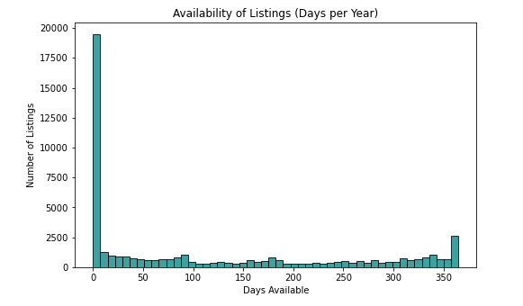
Availability of Listings

Slide 9
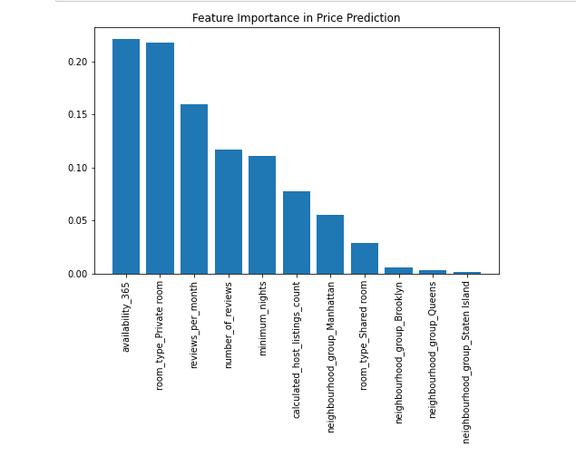
Feature Importance in Price Prediction

Slide 10
Machine Learning Models
• Linear Regression:
– RMSE: ~56.39
– R²: 0.32
• Random Forest Regressor:
– RMSE: ~54.98
– R²: 0.33
• Random Forest performed slightly better.

Slide 11
Conclusion
• Dataset analyzed and cleaned successfully
• Outliers were removed to improve model performance
• Key insights:
– Manhattan and Brooklyn dominate listings
– Entire homes/apartments are most common in Manhattan
– Availability and room type are strong predictors of price
• Machine Learning models showed moderate predictive power
• Random Forest slightly outperformed Linear Regression

